Slide 1

ABM Dissertation
Results Analysis and Writing Improvement

Slide 2
Design of The Simulations
Change the p and q’s value -- Research on Different Probability of Innovators and Imitators Adoption (simulation 1 and 2)
P = 0.01 ~ 0.03 (3 different values)
Q = 0.3 ~ 0.5 (3 different values)
Make part of the population to zero (simulation 3 and 4)
Keep influential agents prop the same (5 different values)
Keep innovator agents prop the same (5 different values)
Change two values together (simulation 5 and 6)
P and Innovator Prop (5 different values)
Innovator Prop and Influencer Prop (5 different values)
Change the Network Type and Connections of agents (on-going)
Random or small-world network (make sure the agent have the same number of neighbours)
Add more neighbour to the agents

Slide 3
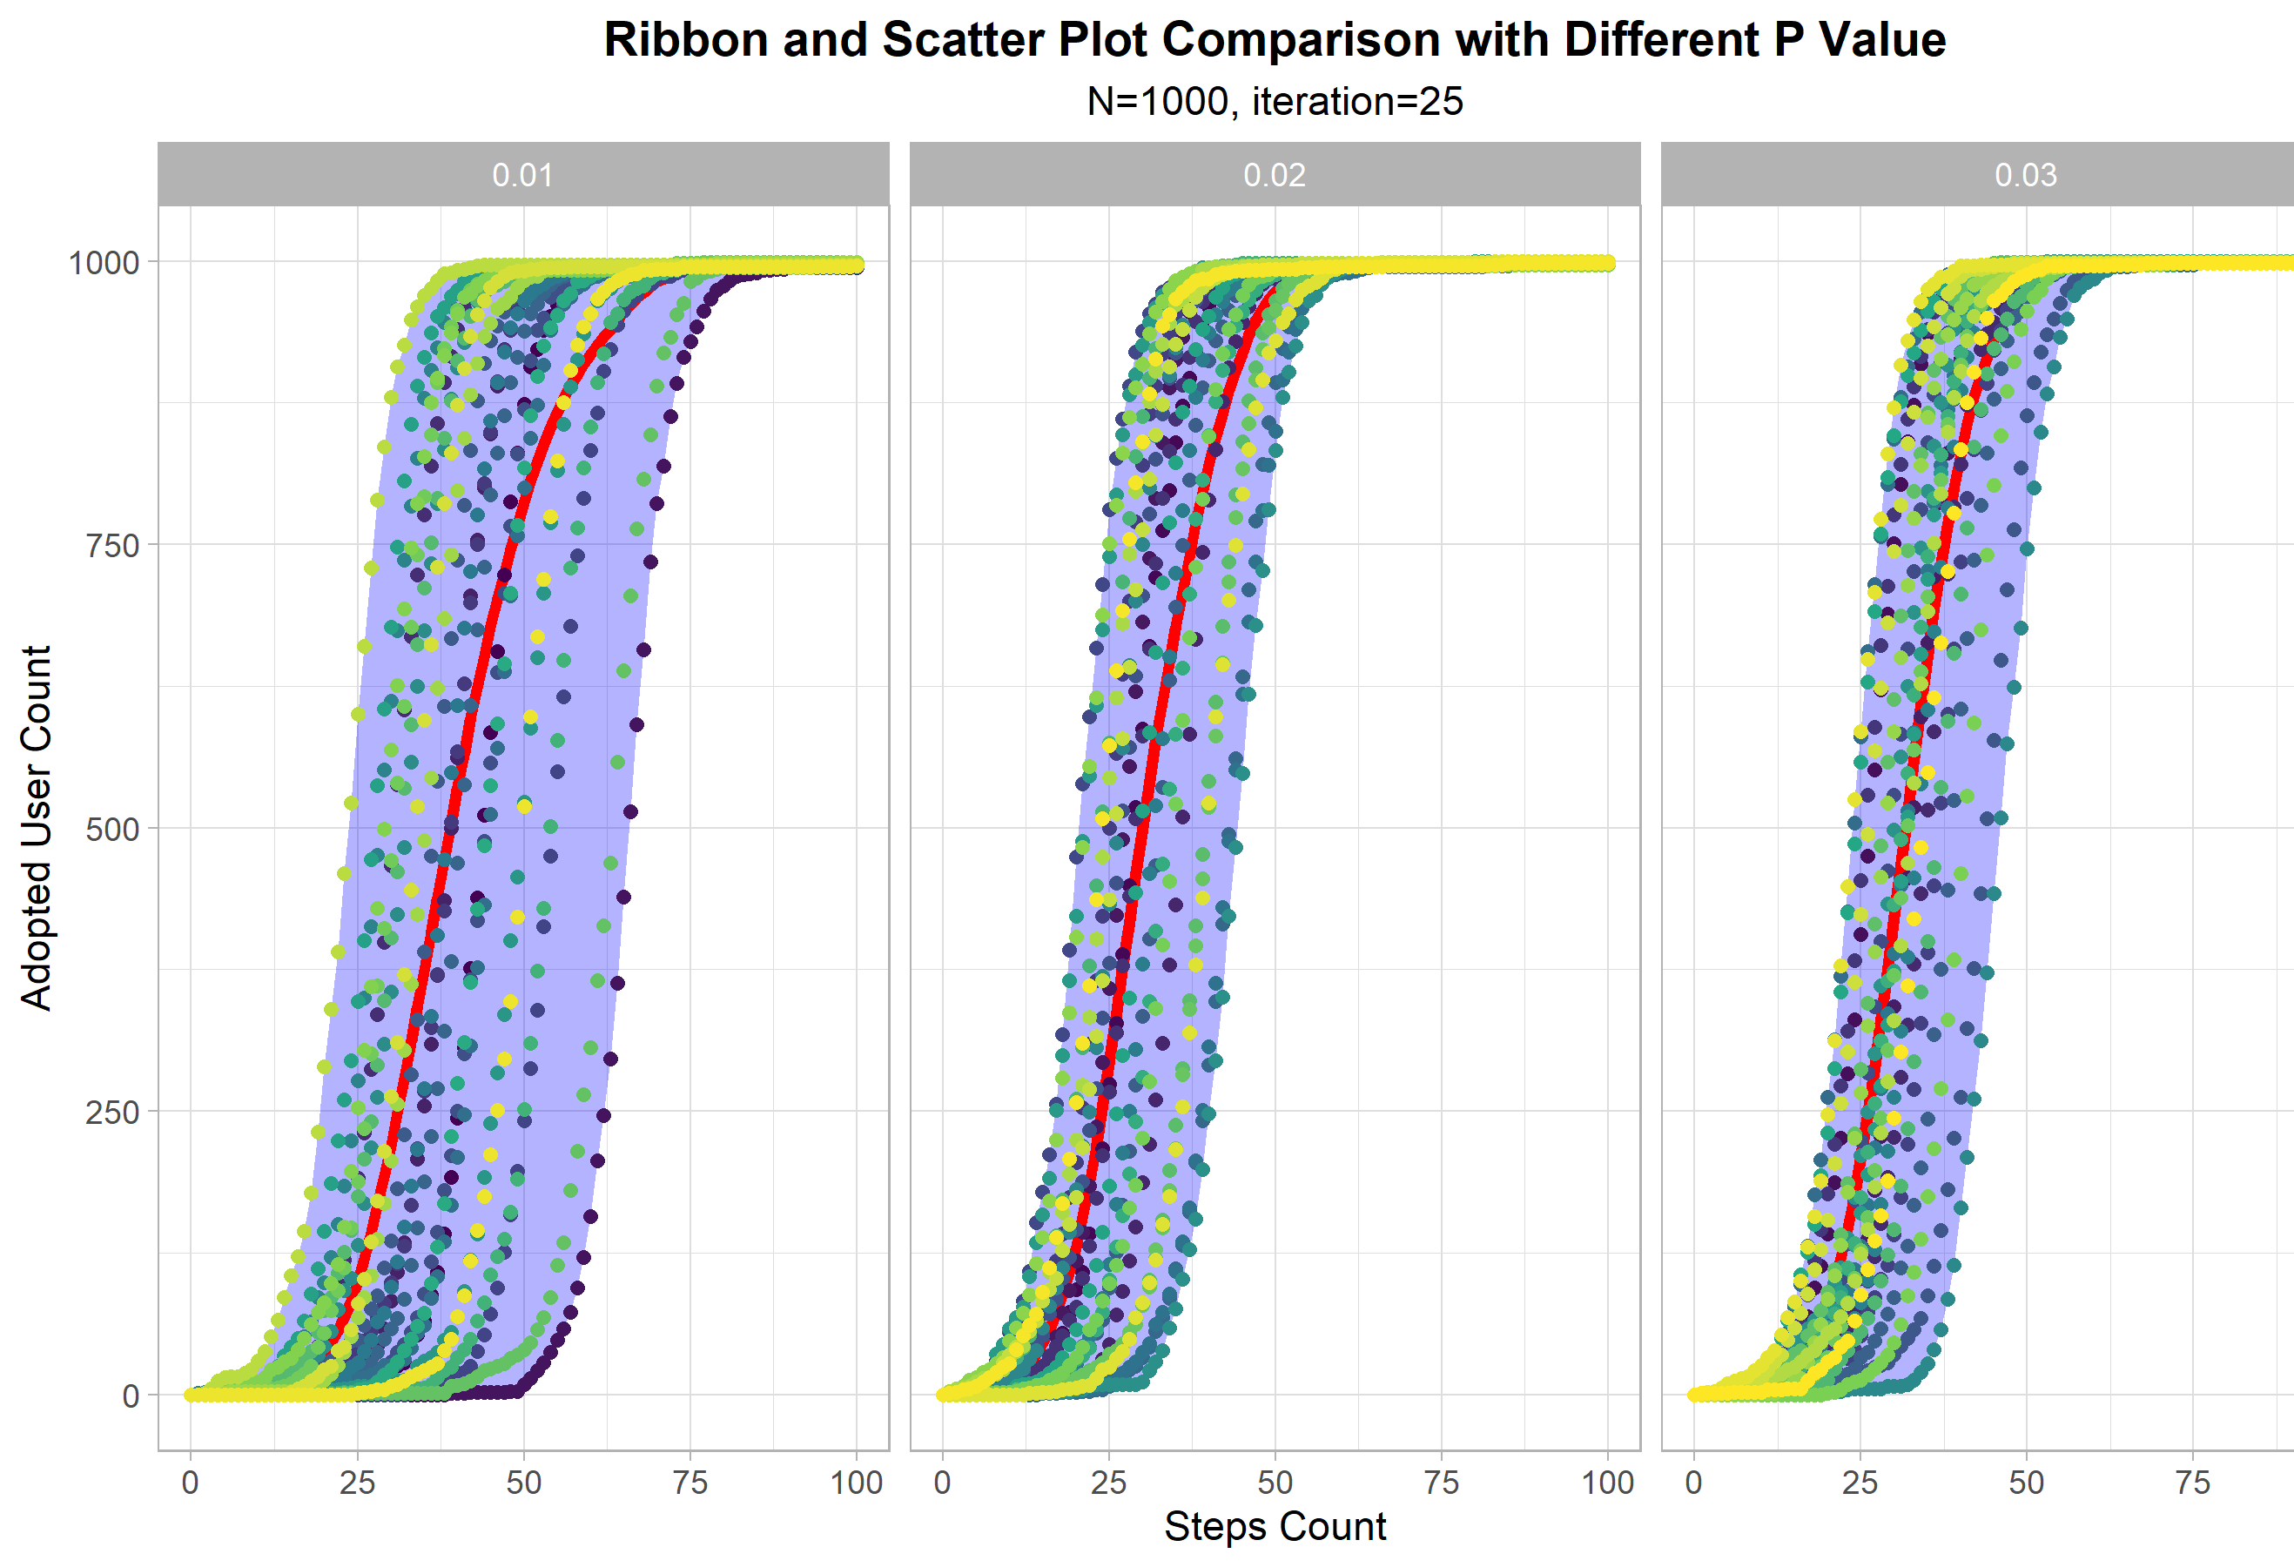
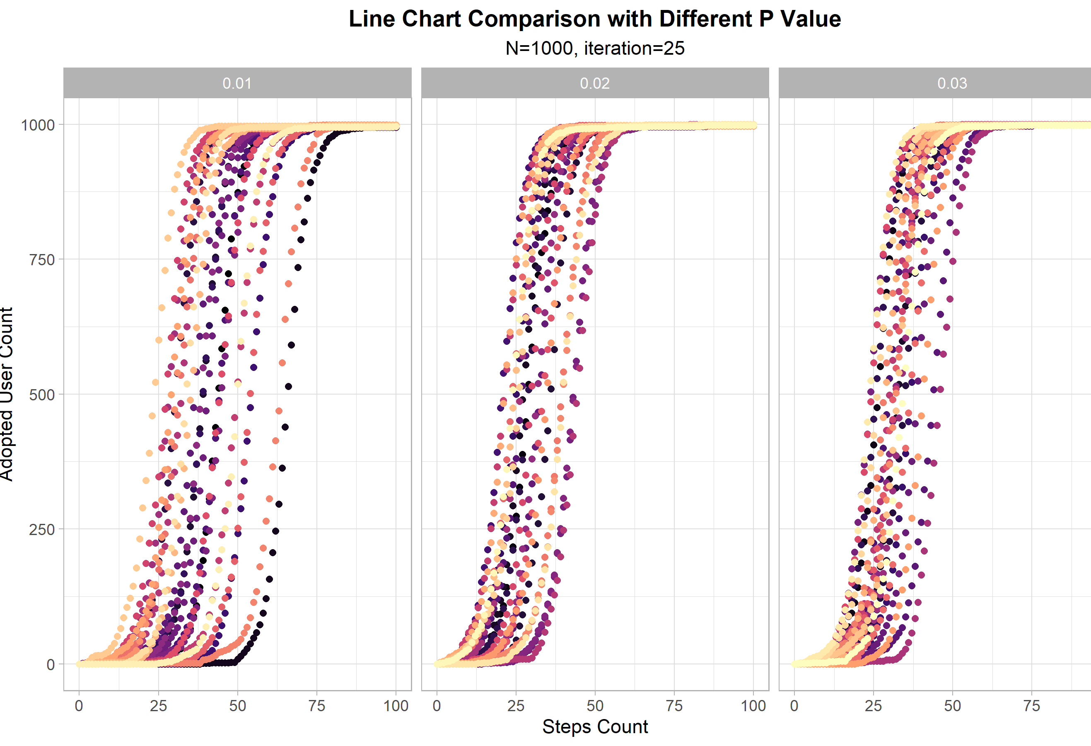
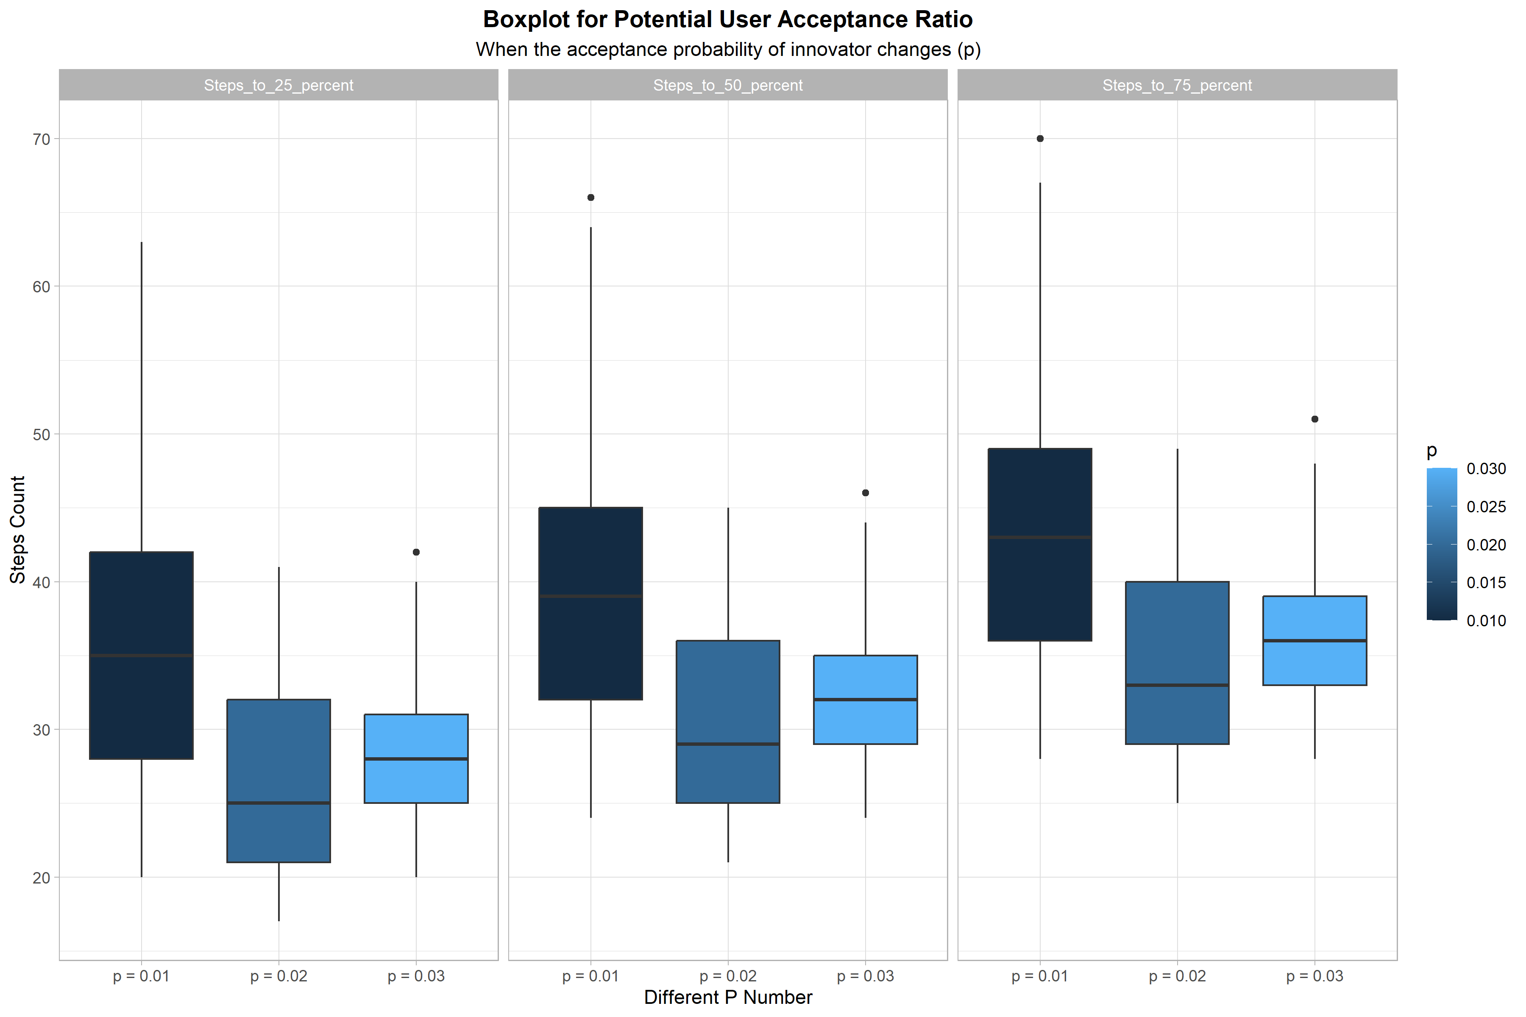
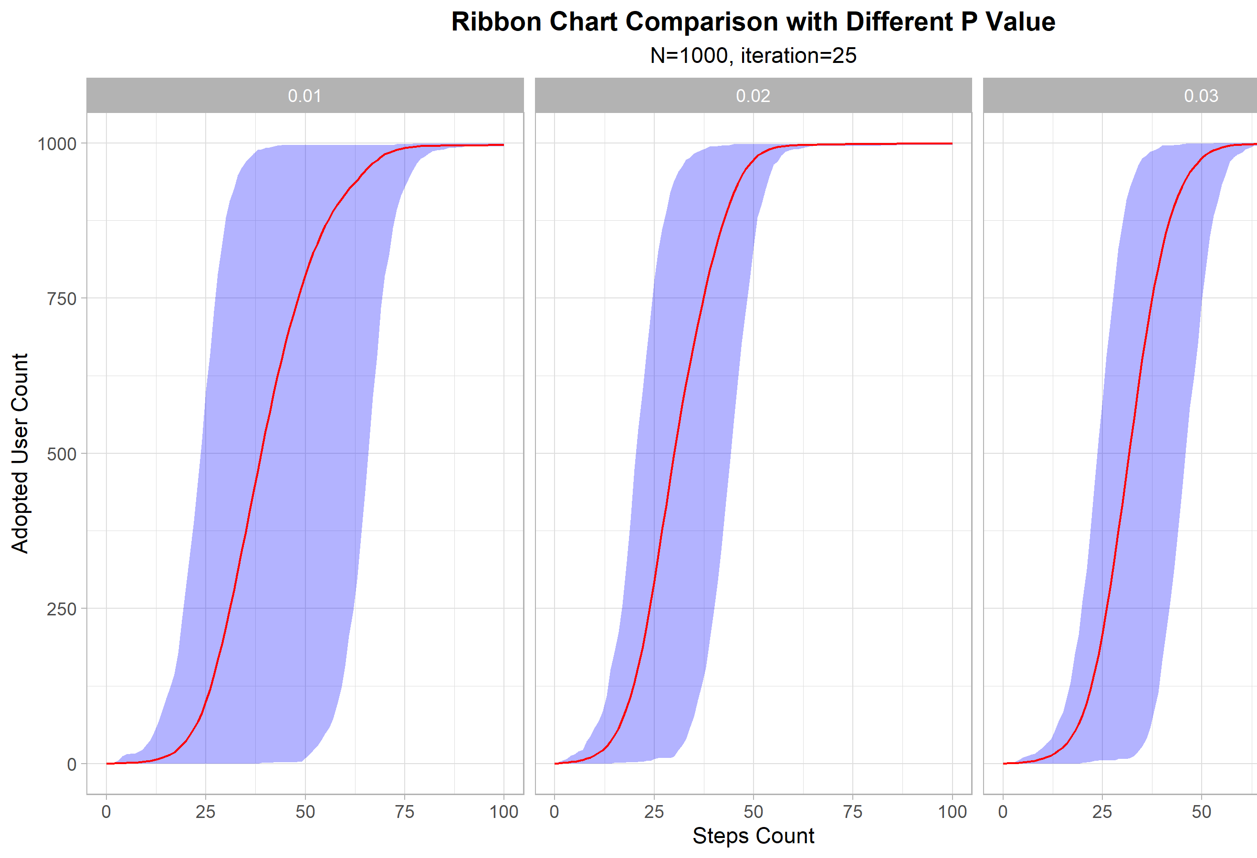
Research on Different Probability of Innovators and Imitators Adoption
When p is getting lower, the Simulation results varies more
Which of the line charts is better?

Slide 4
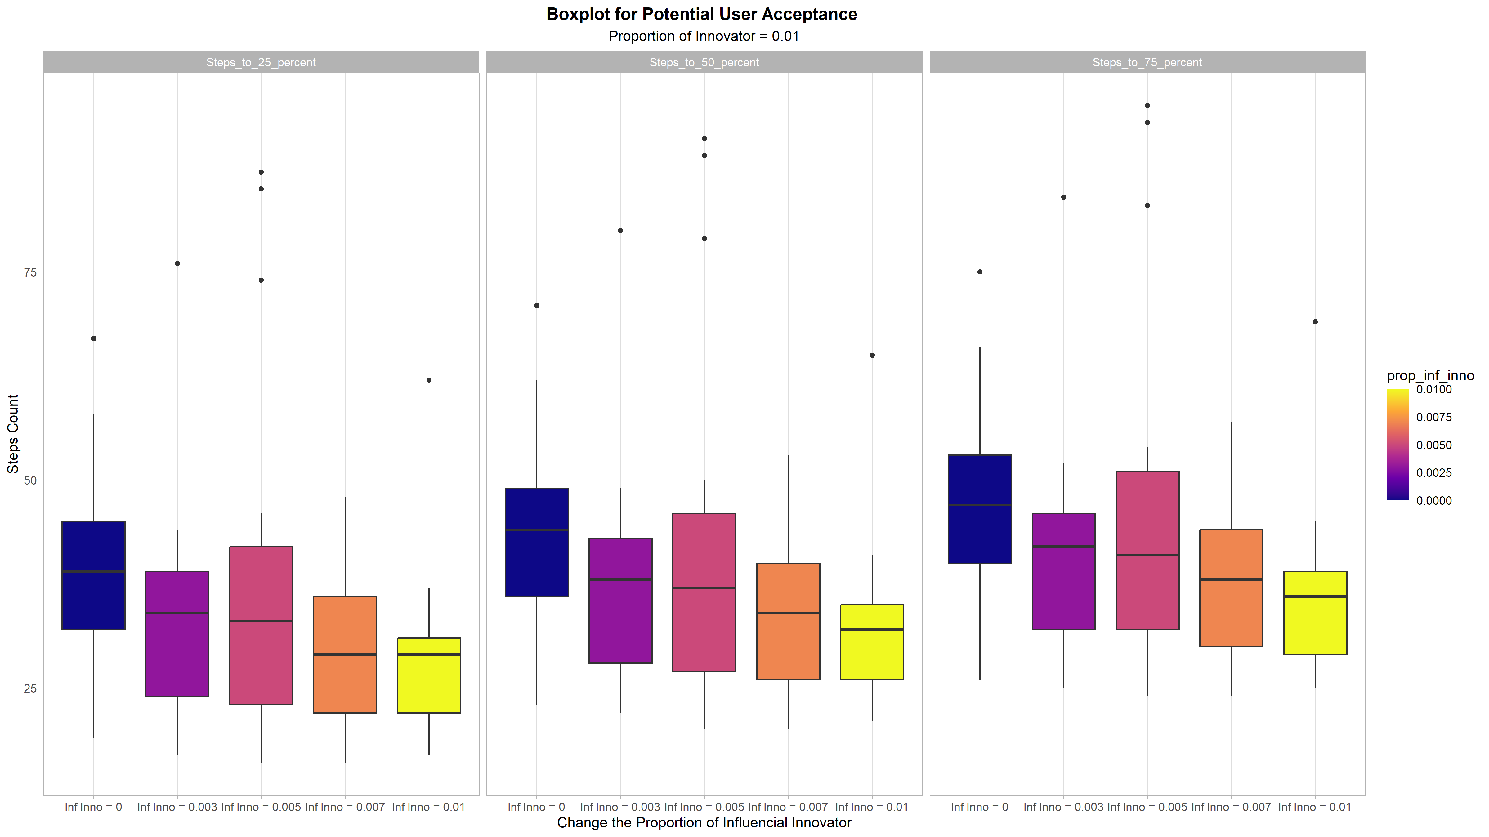
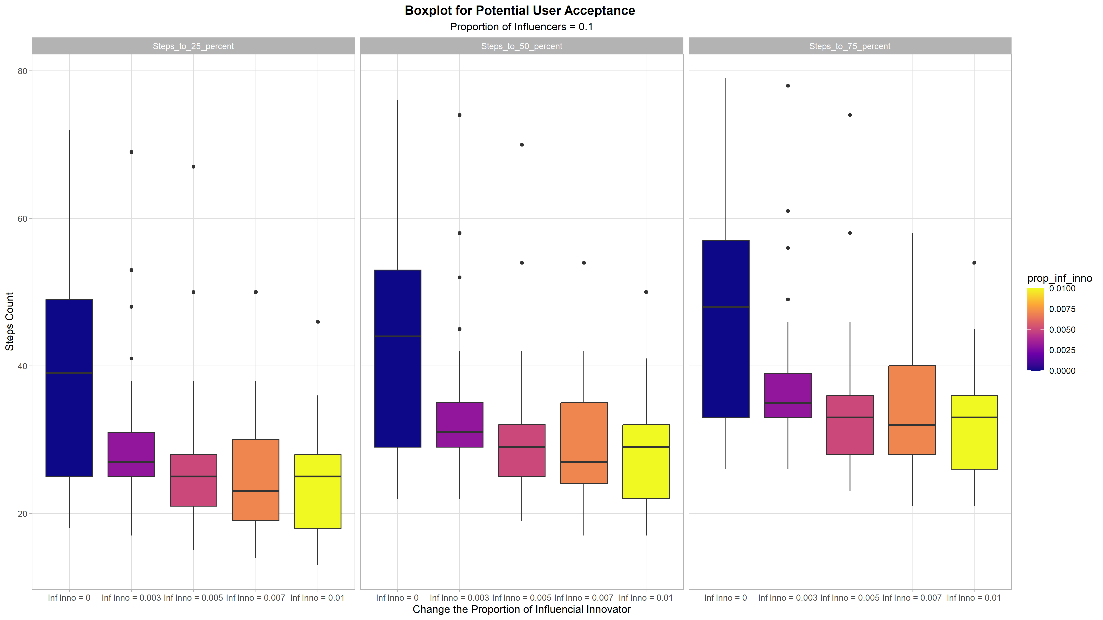
Research on Zero Population
Innovator Prop = 0.01
Influential Prop = 0.1
Make the Influential Innovator Prop changes
How to explain some simulation have a wider width?

Slide 5
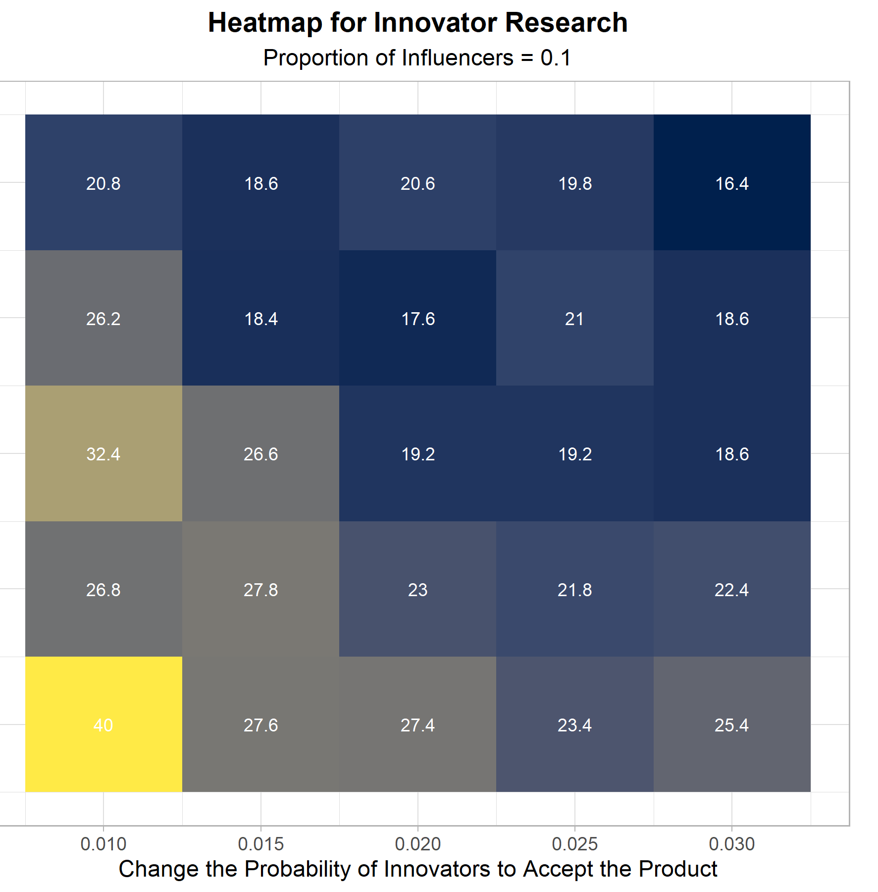
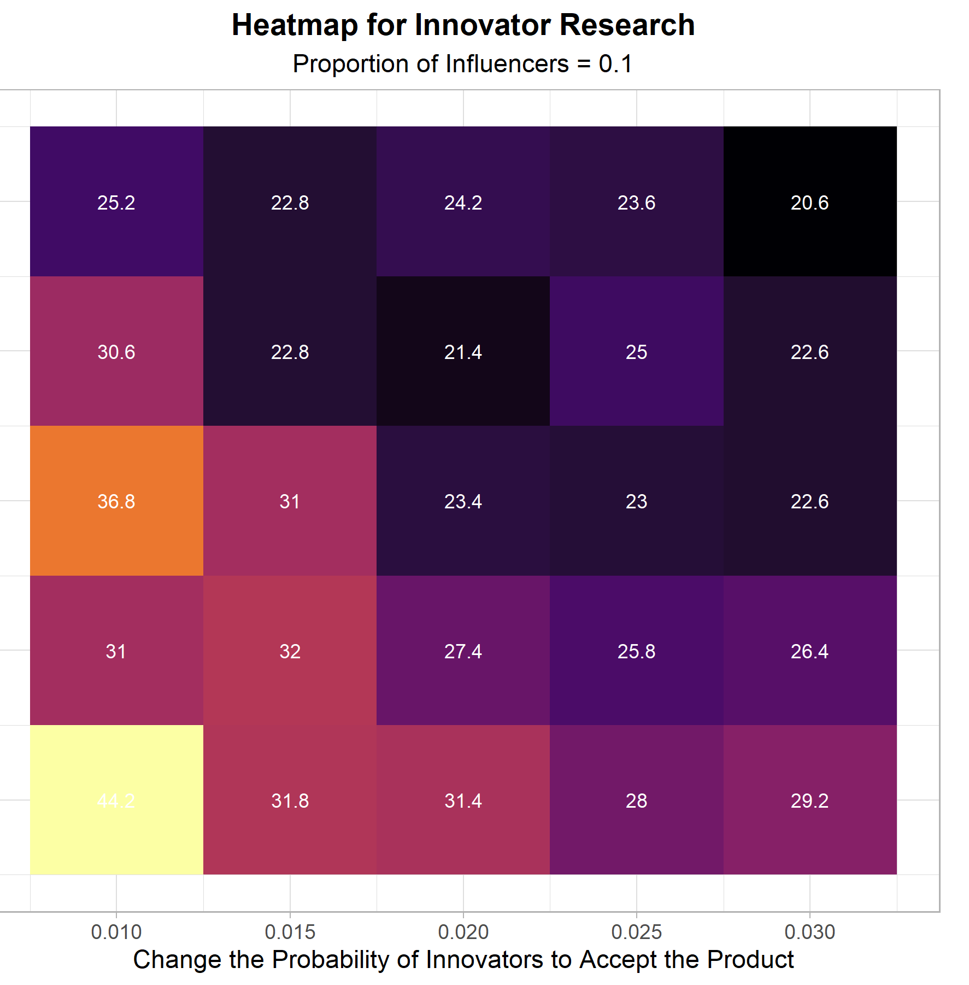
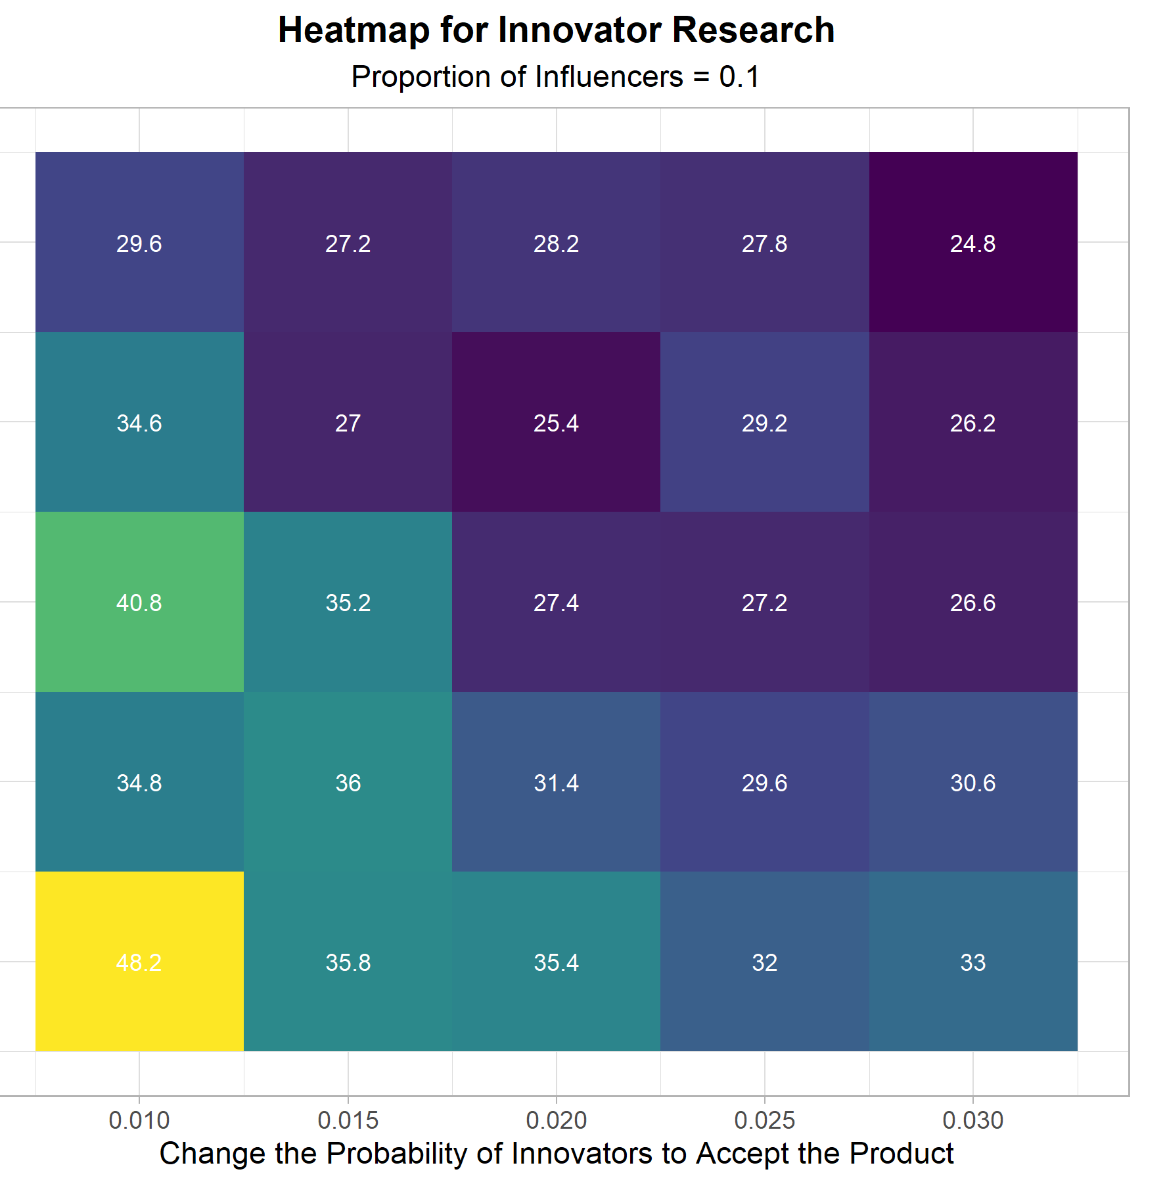
Change p and innovator prop together
The trend is higher p and innovator-prop using less steps to reach the target potential adopters
Maybe 7 different values for each variables is better
How to explain those cells not obey the trends

Slide 6
Add Content to the Dissertation
Model Assumptions for ABM and Test when I introduce the model
Results Explanations (Here I will refer to other ABM jobs)
More different kinds of visualization
More visualization for the results
More flowchart or other graphs for the model introduction

Slide 7
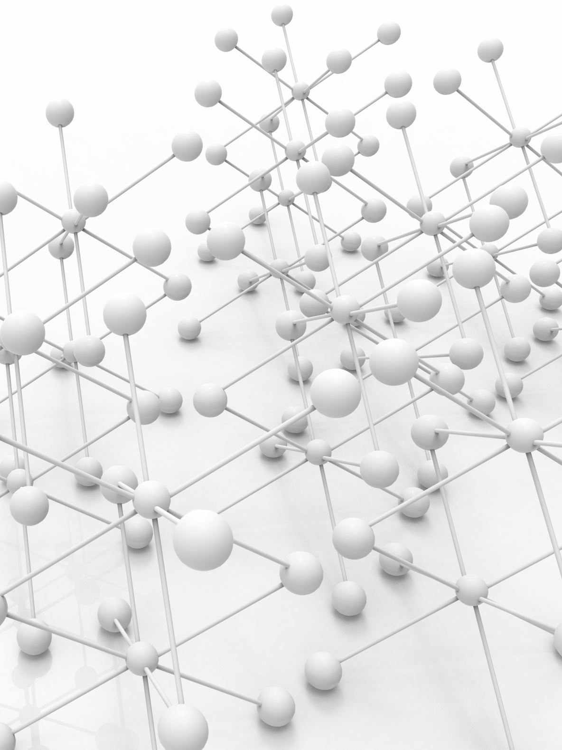
My Recent Works
Re-run the simulations with more choices and deal with the visualizations.
Add network analysis, compare with different network topology when p, q variess.
Finish the result analysis and conclusion part, then introduction and abstract part of the dissertation.
Re-organized the structure of my dissertation.

